Slide 1


A Simple Multi-Borehole Resistivity Method for Small to Large Scale 3D Imaging.
The Method
  Conceptual Sketch
  Description
In Practice
  Small Scale: void detection
  Medium Scale: bedrock characterization
  Large Scale: mineral exploration

Slide 2
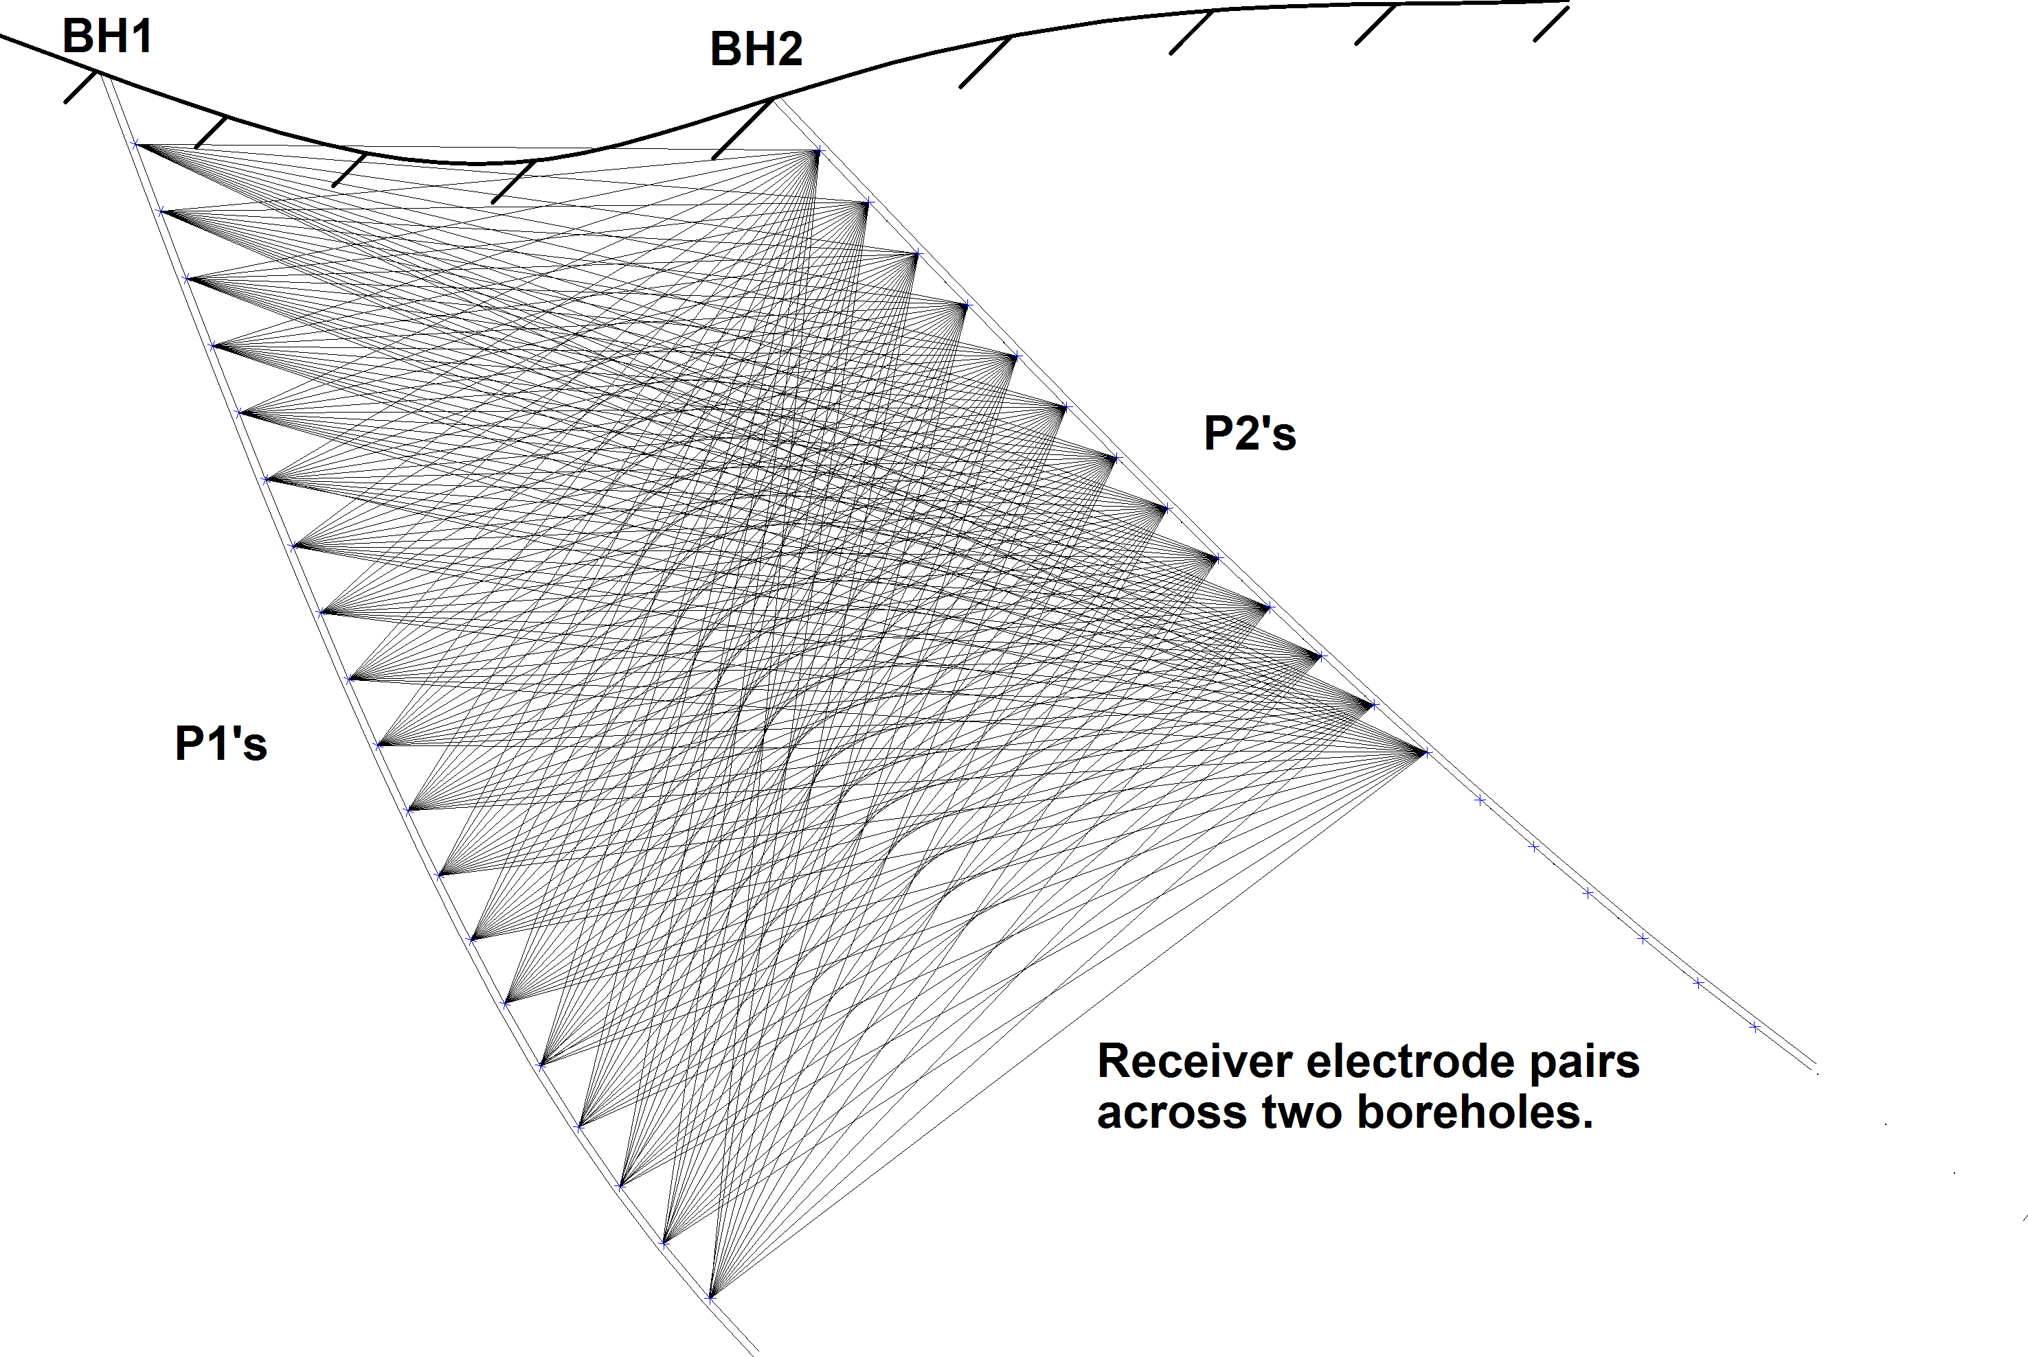
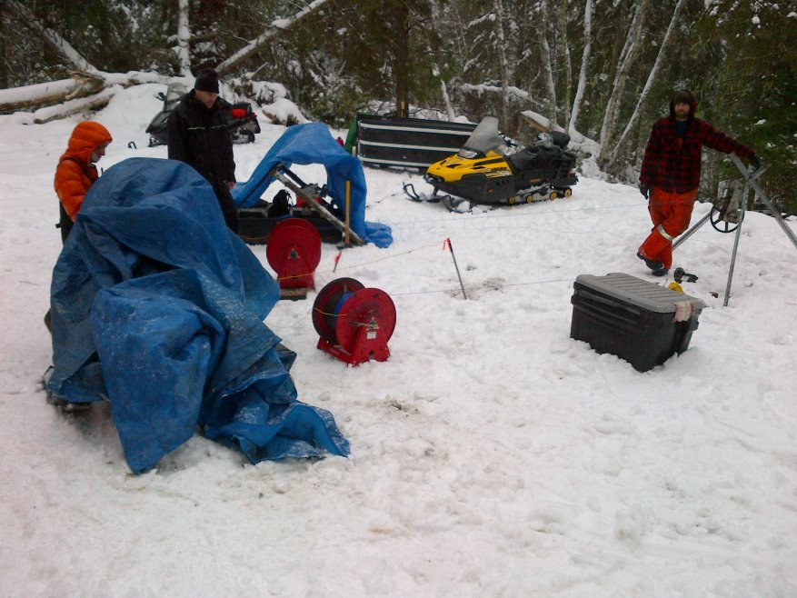
Conceptual Sketch

Slide 3
Description
Transmitter with both electrodes at ‘infinity’ perpendicular to ‘strike’
  Typically greater than 2-3 times the average borehole length from the nearest borehole.
IP receiver P1 and P2 electrodes at each borehole.
  P3-P4 control electrodes located on surface to synchronize and calibrate the receiver for each reading,
  Reading P1-P2 (cross-hole pair), P2-P3, P3-P4 (synchronization/calibration/QA-QC).
Benefits:
  Provides between-borehole and near- or at-borehole information,
  Simple field setup for transmitter:
    Transmitter, wires and electrodes are stationary for entire project.
  Only 1 wire down each borehole:
    eliminates inductive coupling between adjacent wires,
    reduces risk of winch chaining errors,
    deeper boreholes can be logged,
    no costly probes and no need to dummy-probe boreholes,
    Multi-conductor cables can be easily used for short holes (e.g., less than ~30m).

Slide 4
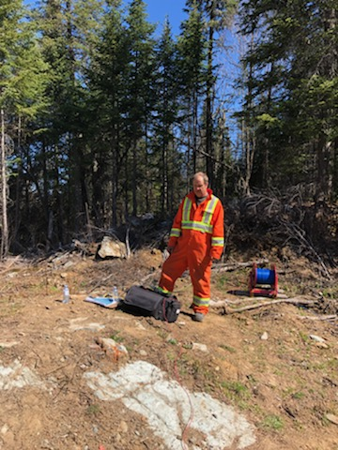
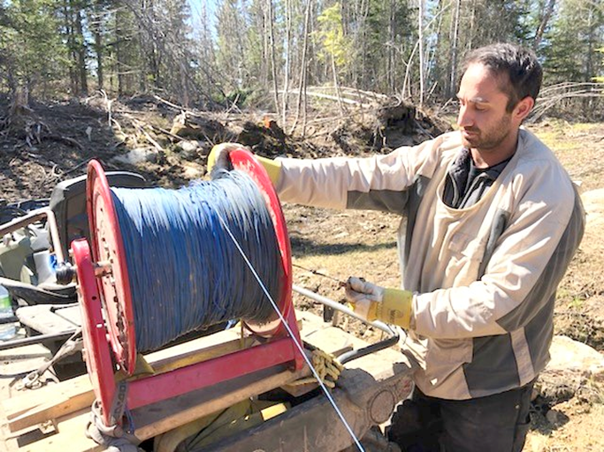
In Practice
    We pick an ‘anchor hole’ and move P1 electrodes at larger intervals than the ‘paired hole’ where P2 moves at smaller intervals,
    For each P1 position in the ‘anchor hole’, we log every position in the ‘paired hole’
    Typically the planned ‘anchor hole’ reading interval depends on factors such as:
Number & distribution of borehole pairs relative to the target (i.e., ideally not a fence of boreholes),
Time allowed for data acquisition,
For a mineral exploration site with several ~300 m boreholes, anchor holes usually at 50-m intervals and paired holes at 10-m intervals.

Slide 5
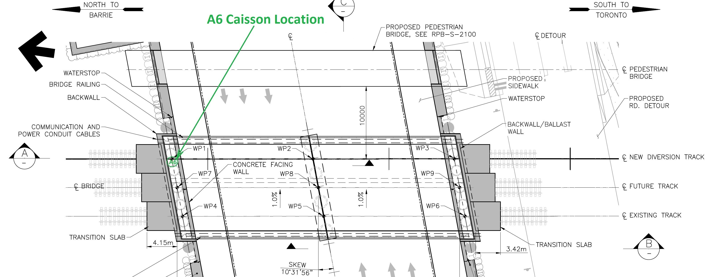
The goal of the work was to identify and characterize as accurately as possible potential voids and boulders in the immediate vicinity of the A6 caisson,
Four (4) uncased boreholes were drilled to allow for the cross-hole survey work.

Slide 6
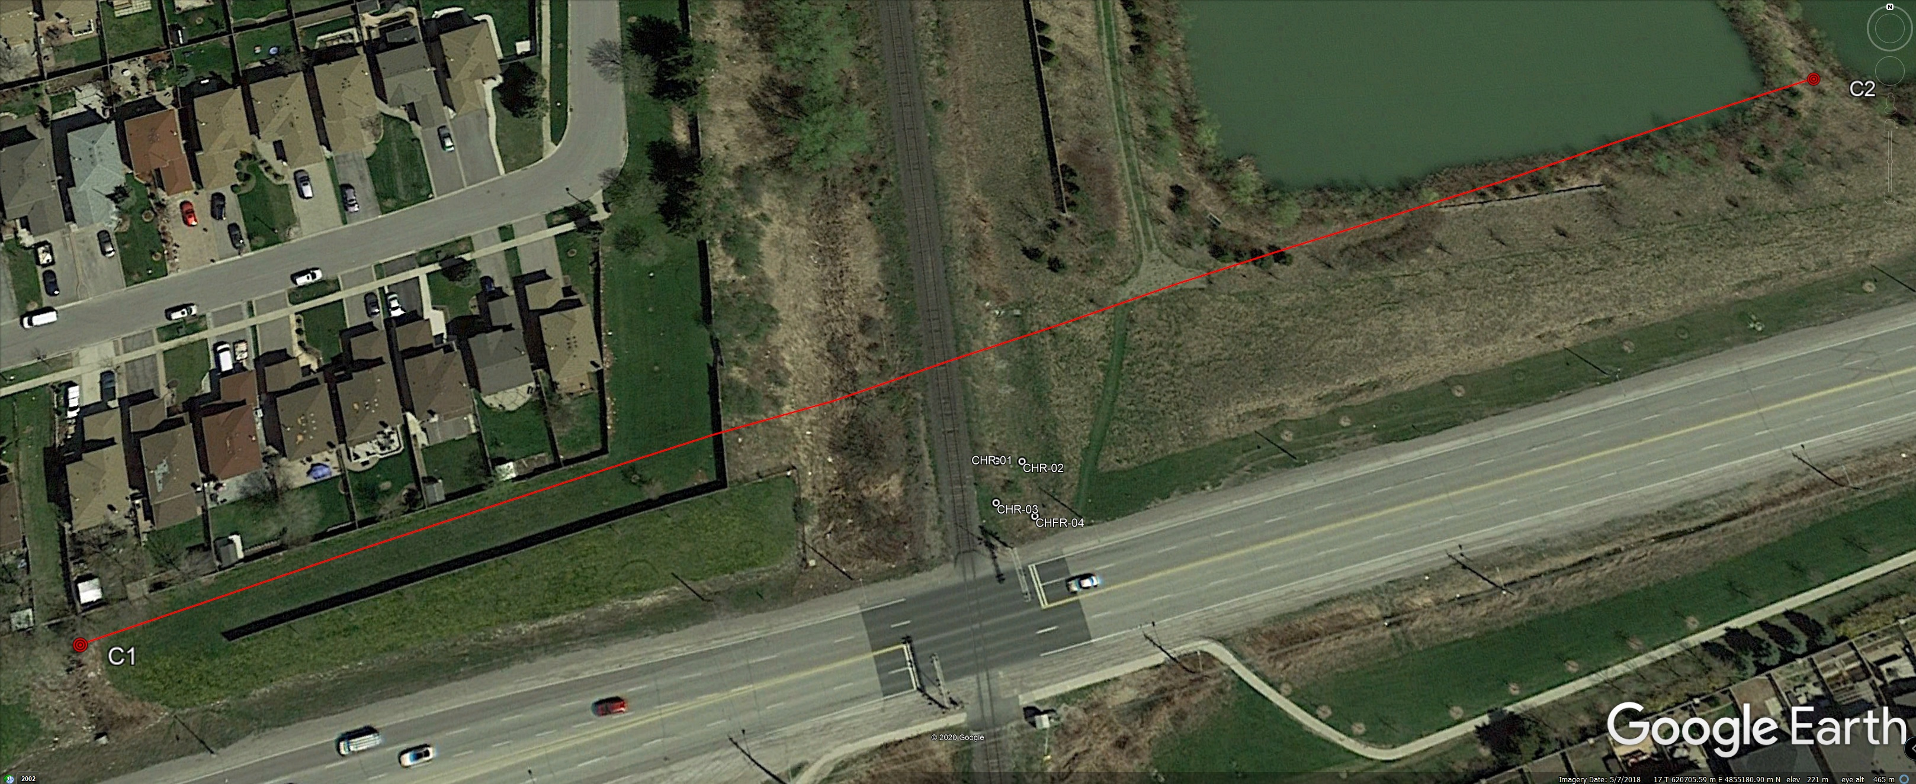
Transmitter electrodes located in safe areas next to water.
Locate sheets showed that there were no significant pipes or utilities along the vector between C1 and C2,
The transmitter current was approximately 2.3A for the duration of the crosshole surveys,
The output voltage setting was 100 Volts – the minimum setting for this transmitter,
C1-C2 = ~300m apart, Rx electrodes 1/2m apart.

Slide 7
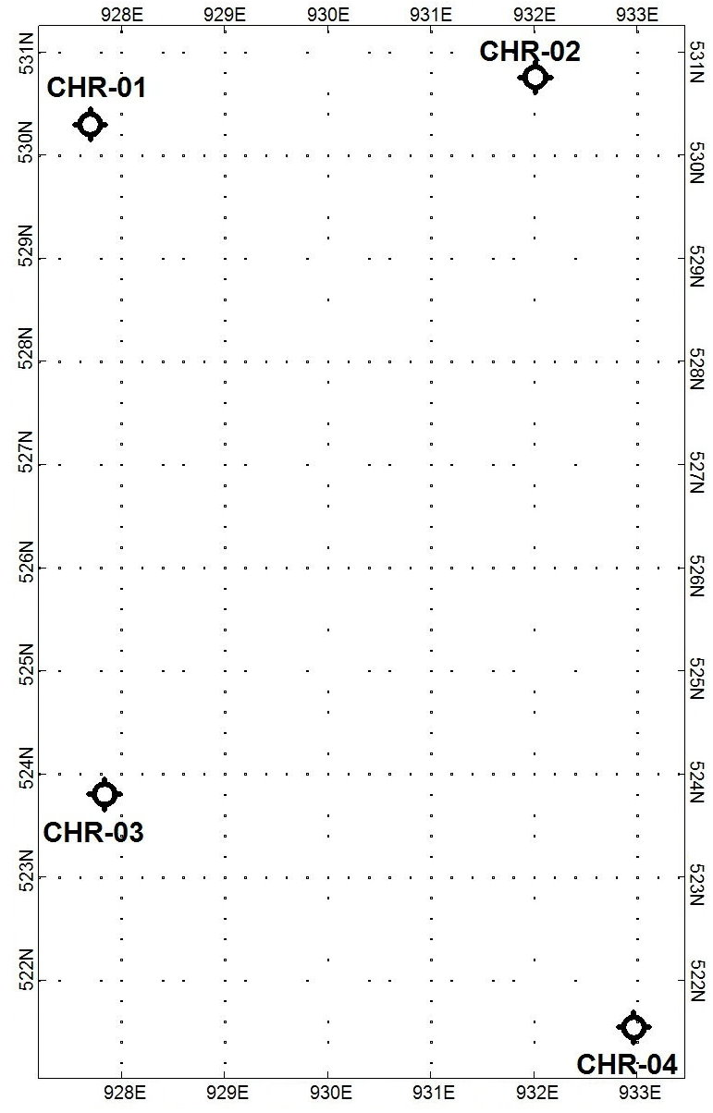
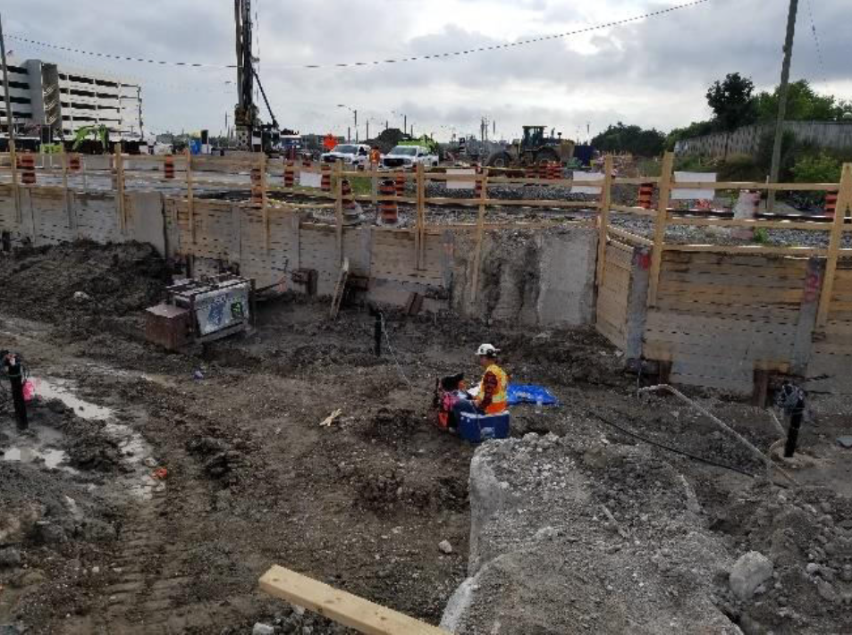
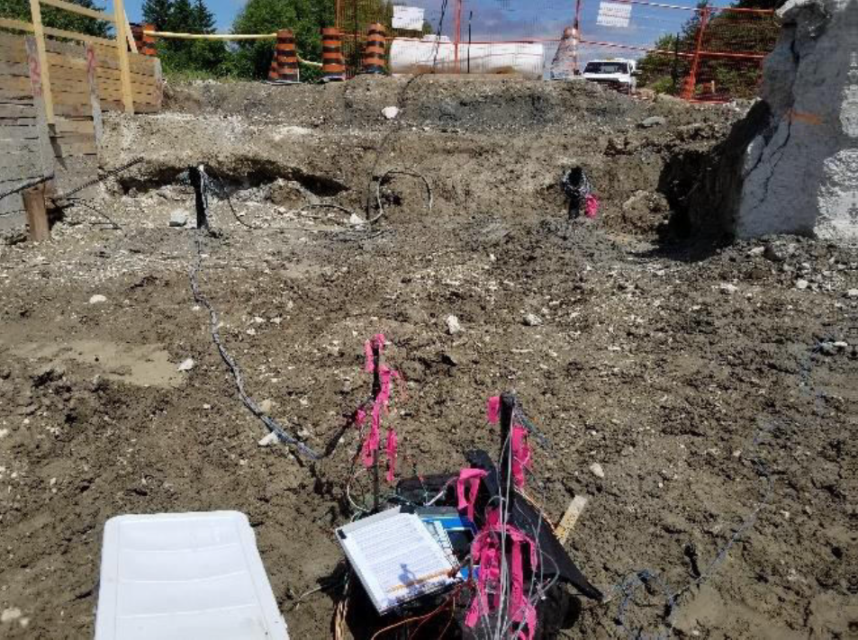
Borehole Locations: within 10m x 5m area.

Slide 8
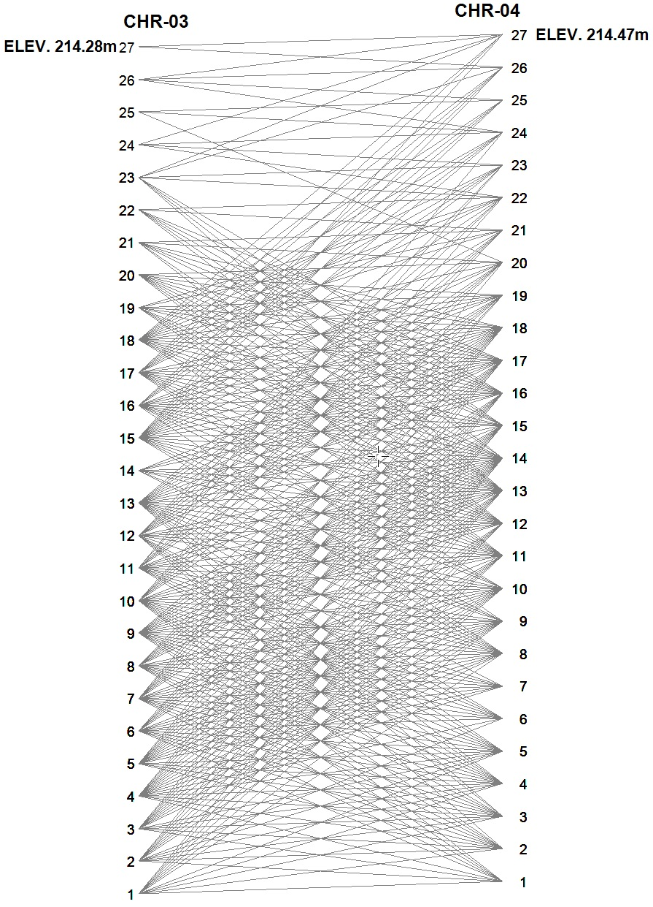
There were 906 reading vectors recorded and all were used for subsequent inversion modeling.

Slide 9
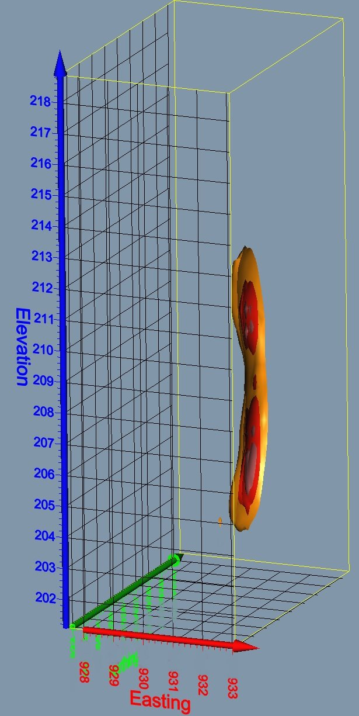
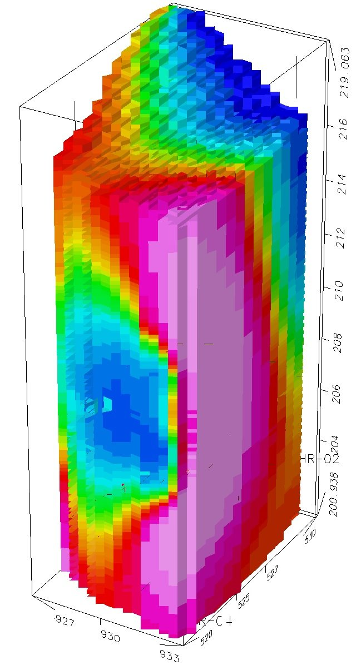
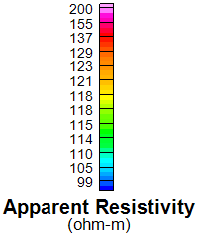
Reddish shading is high resistivity, bluish shading is low resistivity,
The 1st image indicates a ‘High Resistivity Zone’ at CHR-04,
This ‘High Resistivity Zone’ is generally greater than 200 ohm-m or less than 5 mS/m which is typical of ‘clean sand’,
The centre of the defined zone is at approximately elevation 207 metres at 524N which is a couple metres north of CHR-04,
Note that the original location of CHR-04 was located 3 metres north of the present location. That borehole was abandoned due to the likely intersection of concrete,
An additional peak resistivity high zone centred at elevation 211.5 m could indicate sandy soils encountered in CHR-04 are settling and possibly loosening due to source voids below at the ‘High Resistivity Zone’.

Slide 10
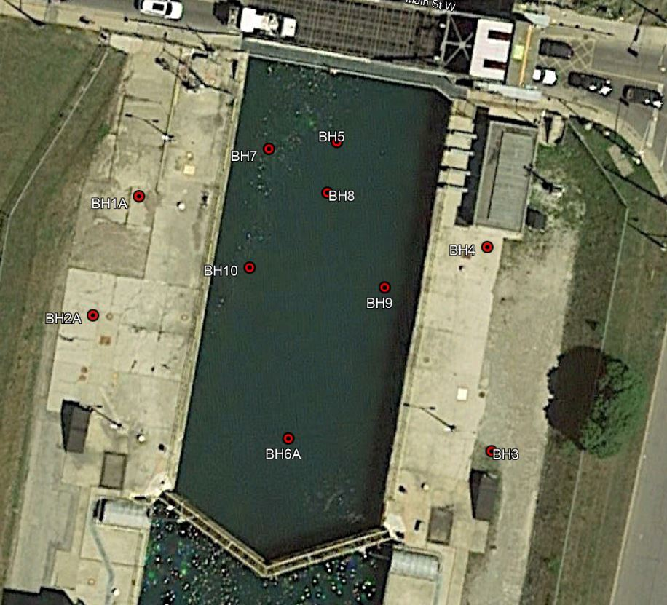
The purpose of the work was to map subsurface anomalies under a waterway floor and monoliths/walls that could result from voids or bedrock variations.

Slide 11
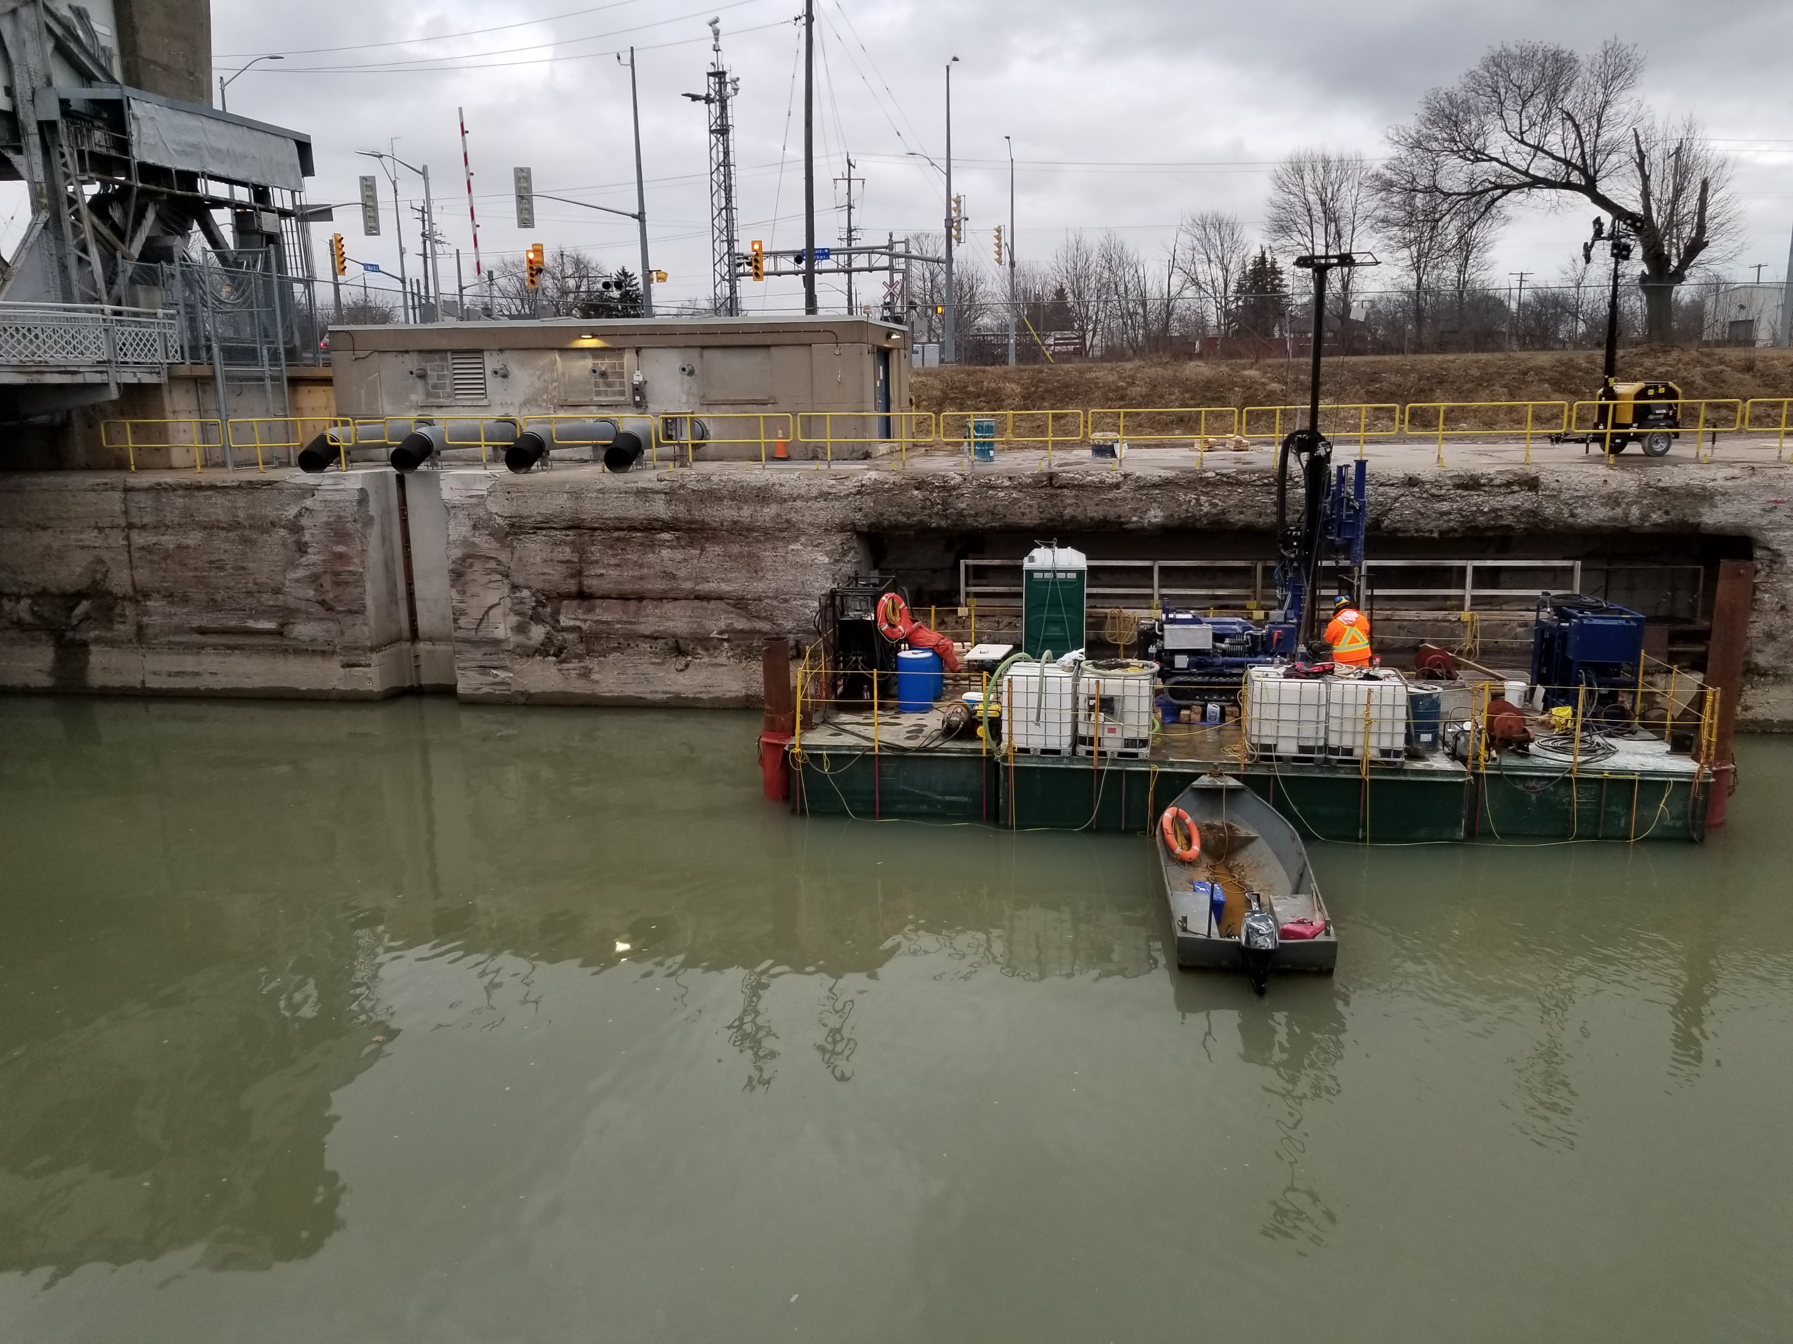
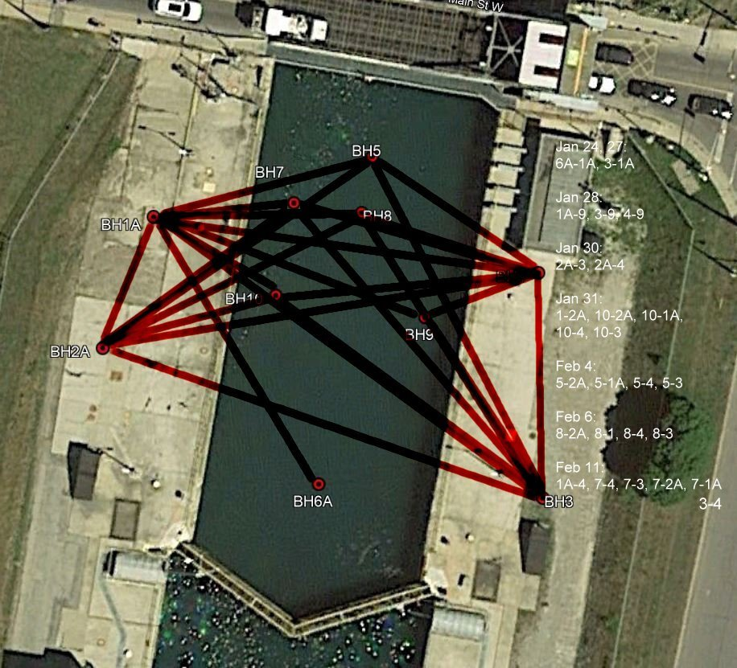
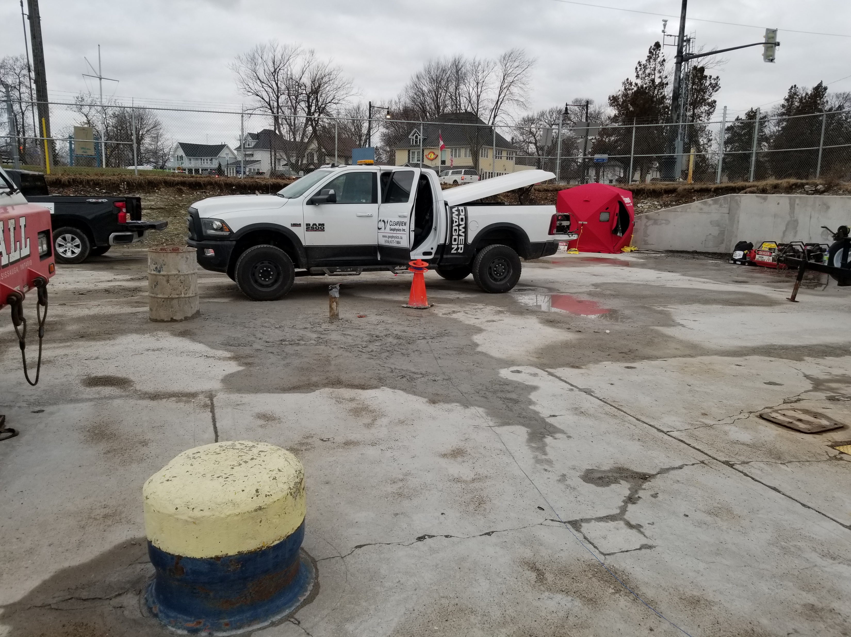
Twenty-six (26) borehole pairs were logged. Access to the land boreholes (i.e., 1A, 2A, 3, 4) was by truck and access to the marine holes (i.e., 5, 6A, 7, 8, 9, 10) was by crane, boat and barge.
Anchor-hole set at 4m intervals,
Paired-hole read at 1m intervals,
C1-C2 = ~500m apart.
Tx = 2.3 A.

Slide 12
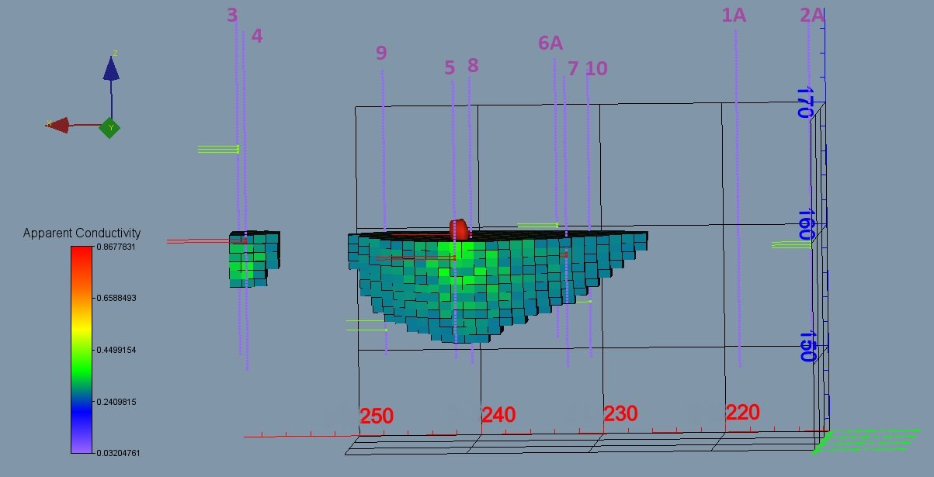
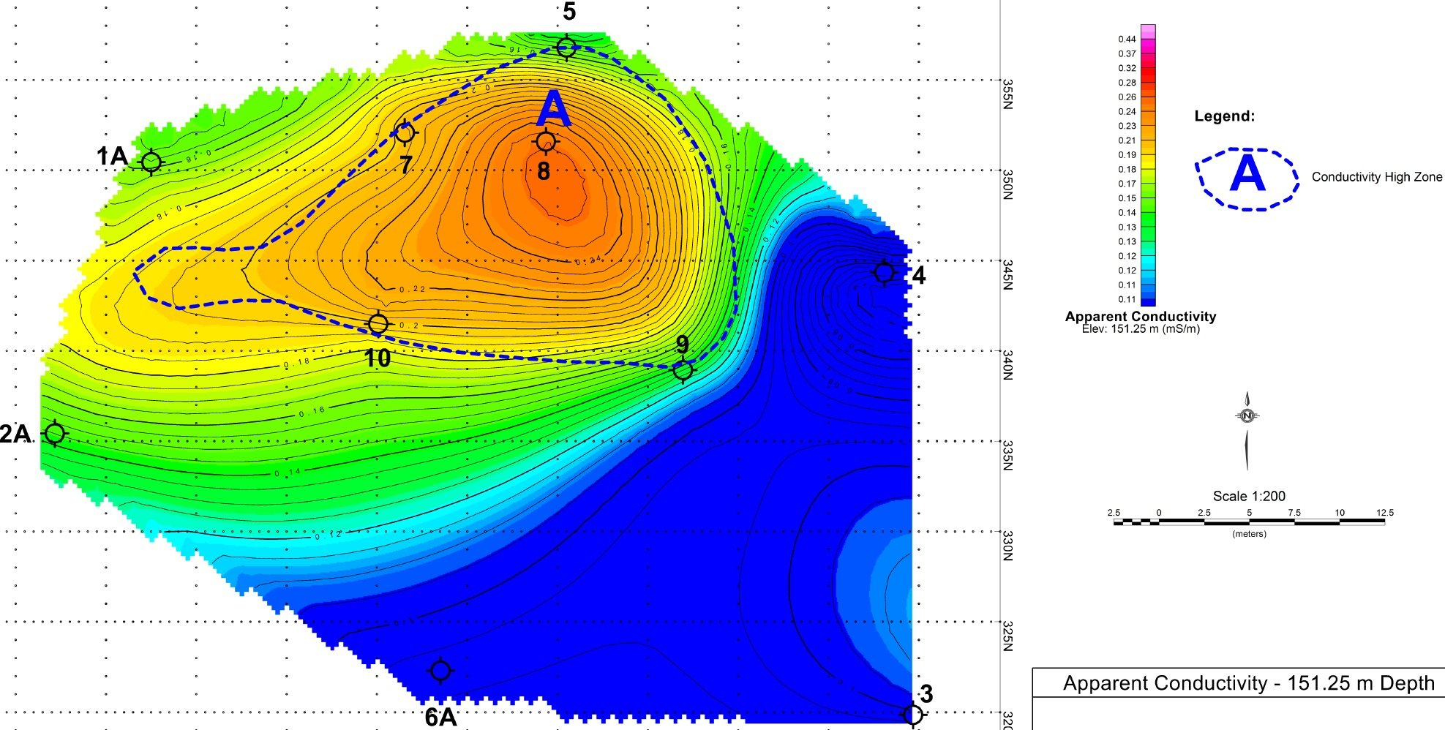
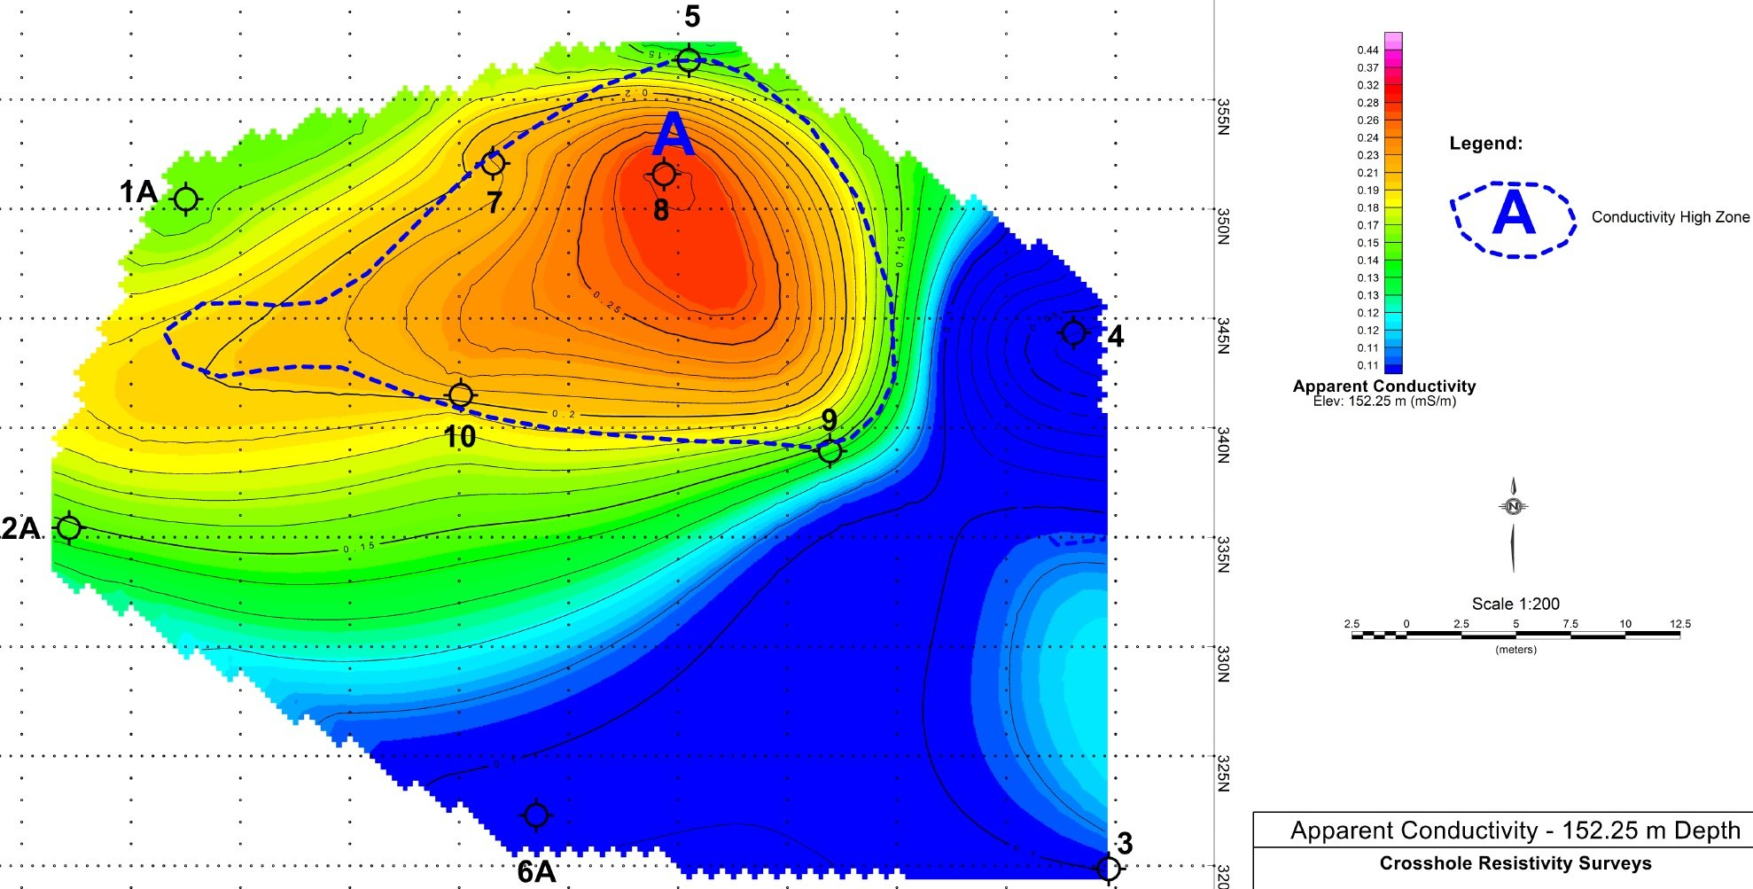
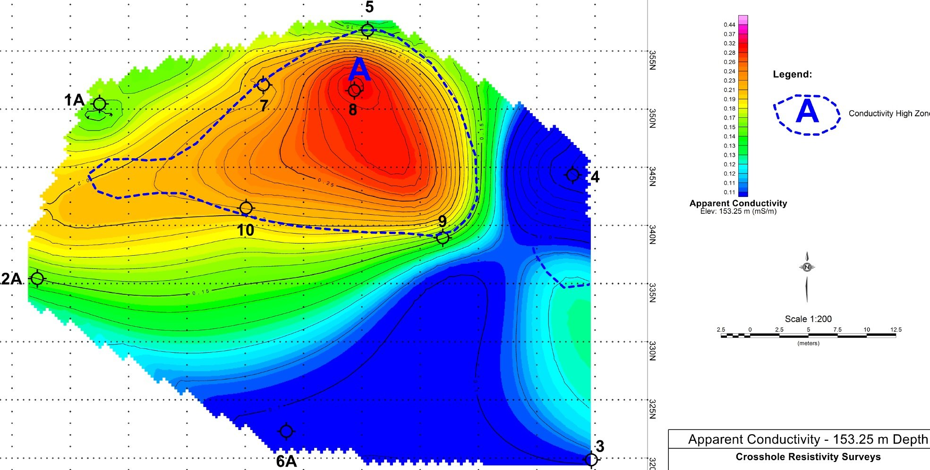
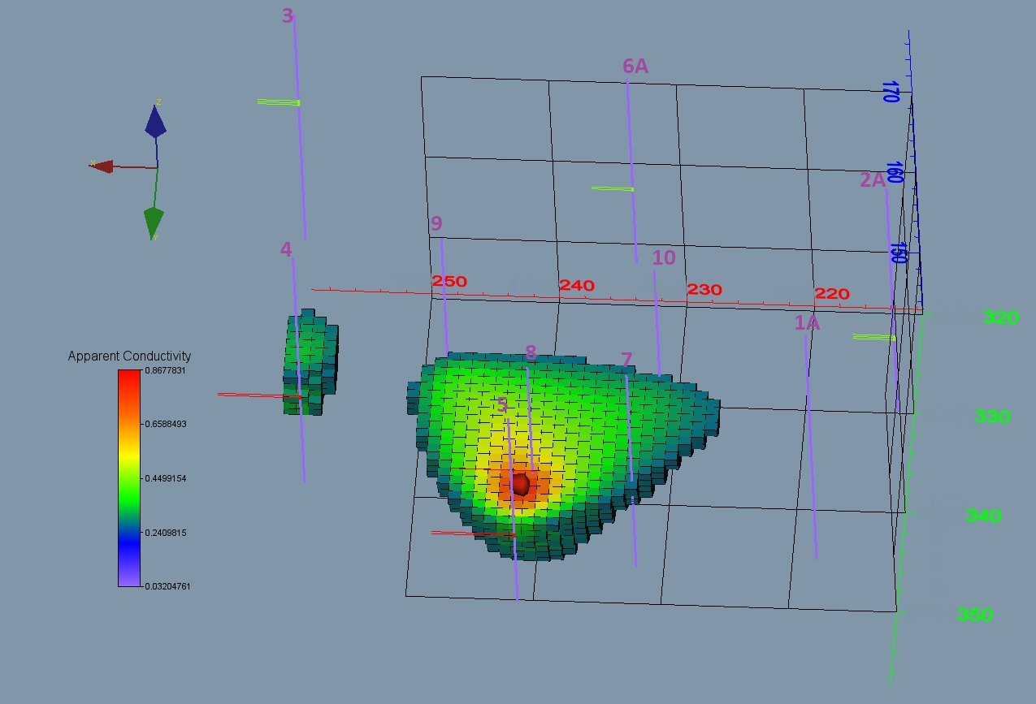
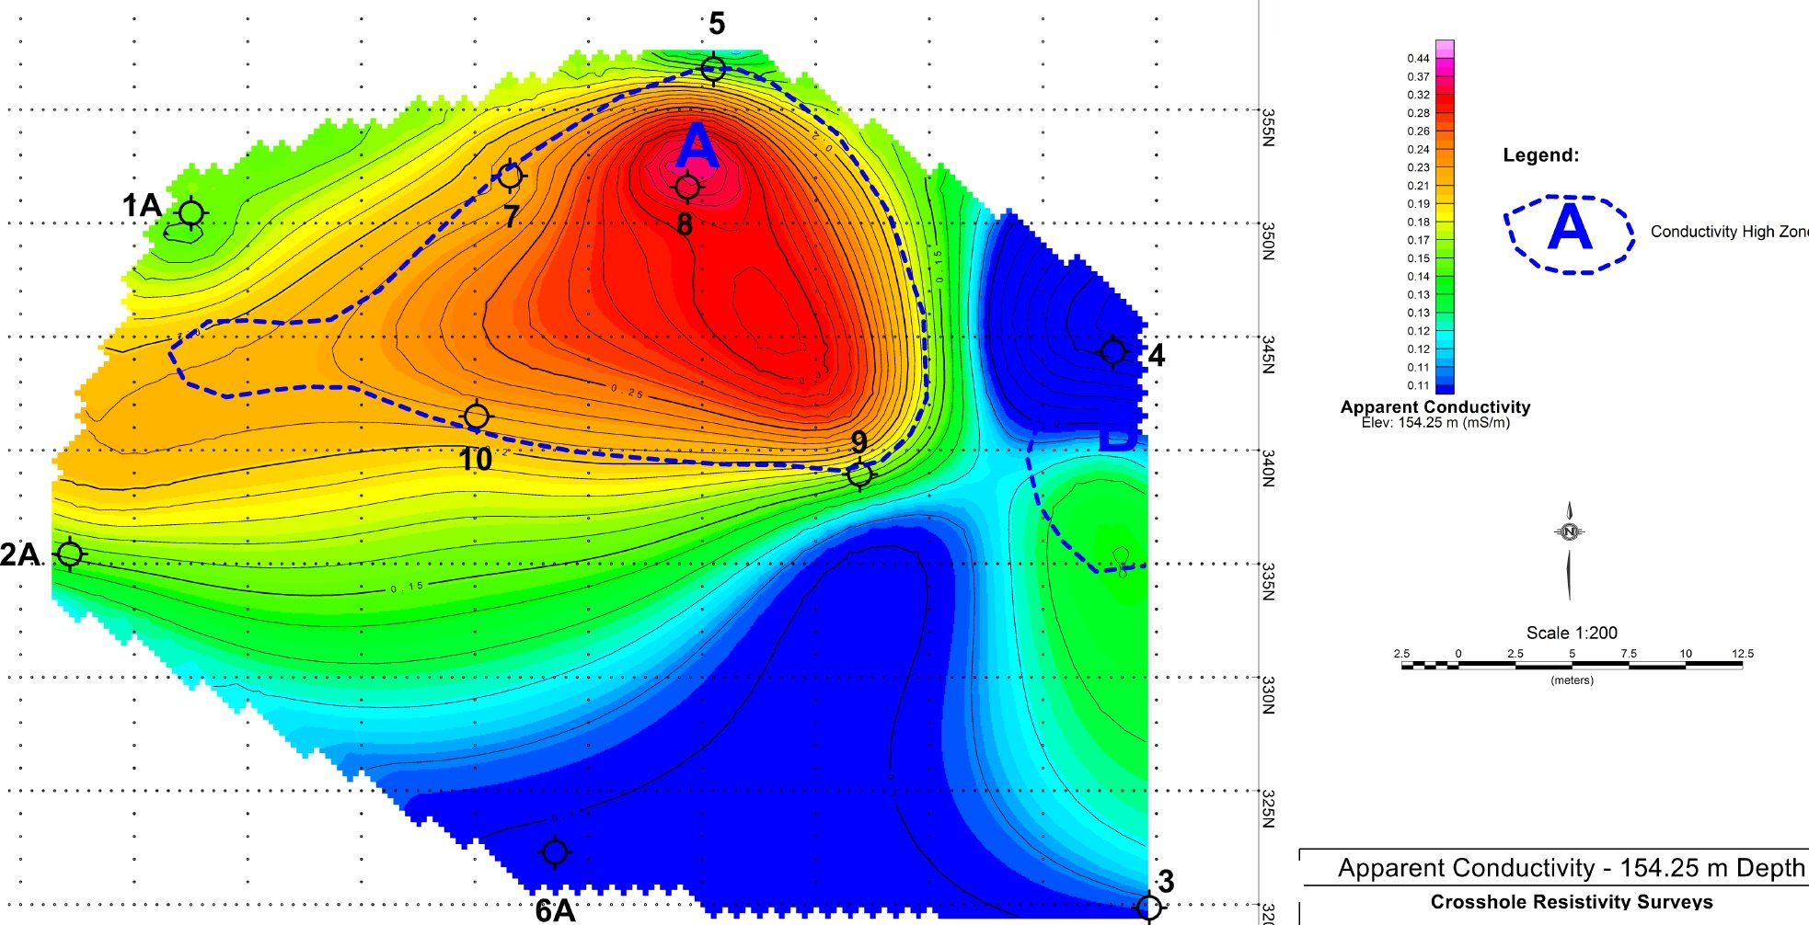
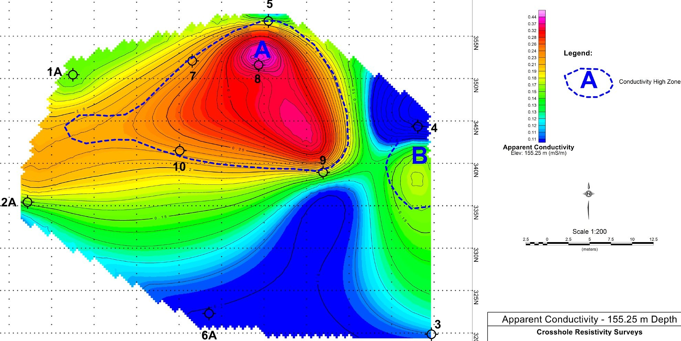
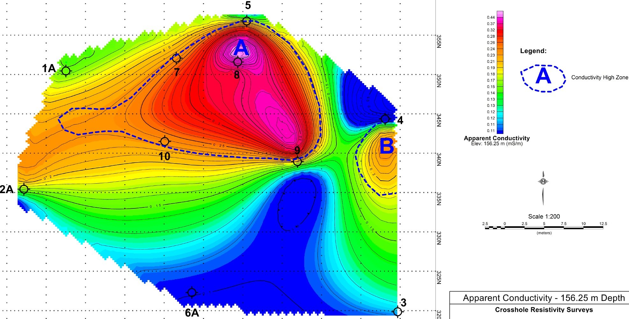
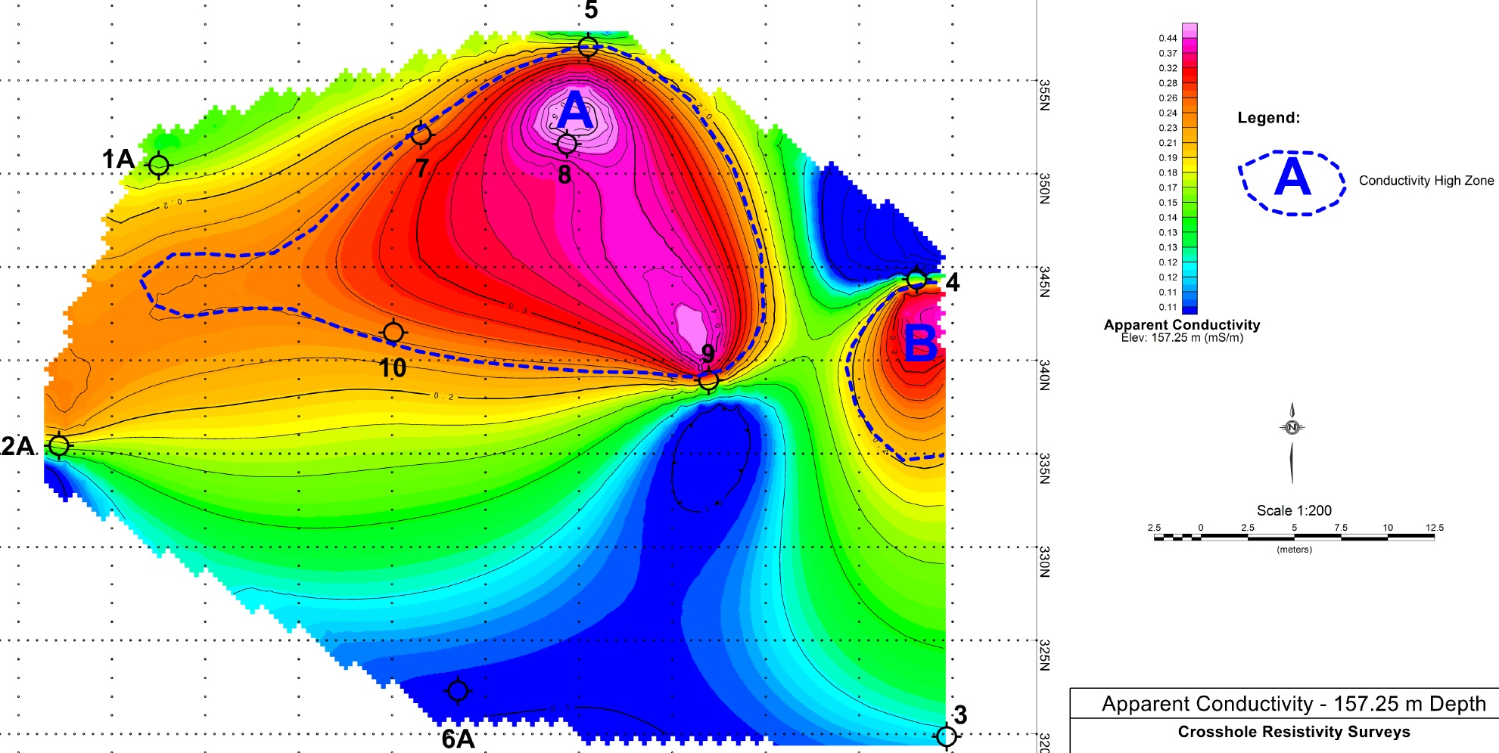
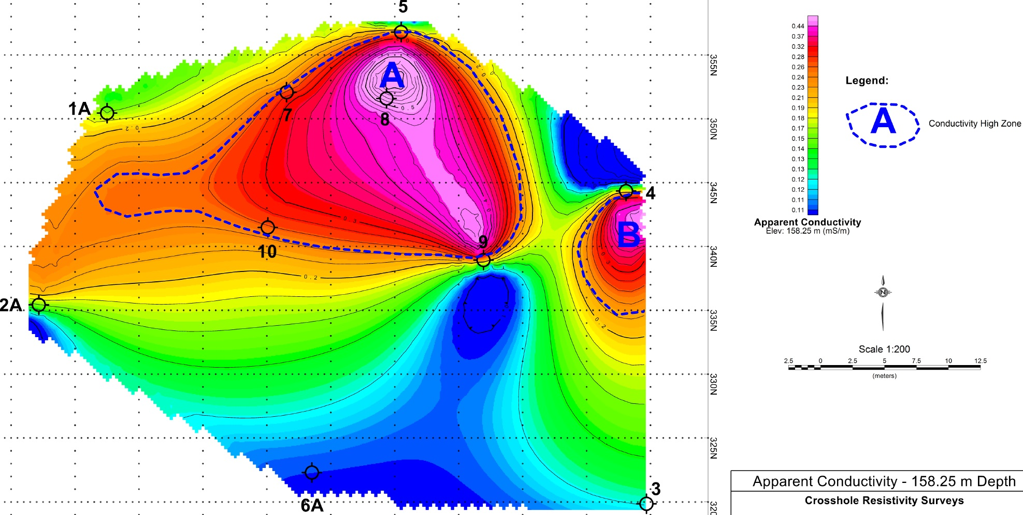
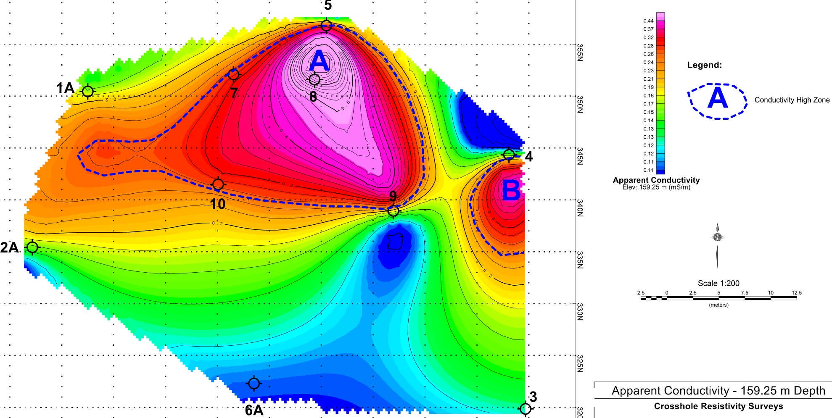

Slide 13
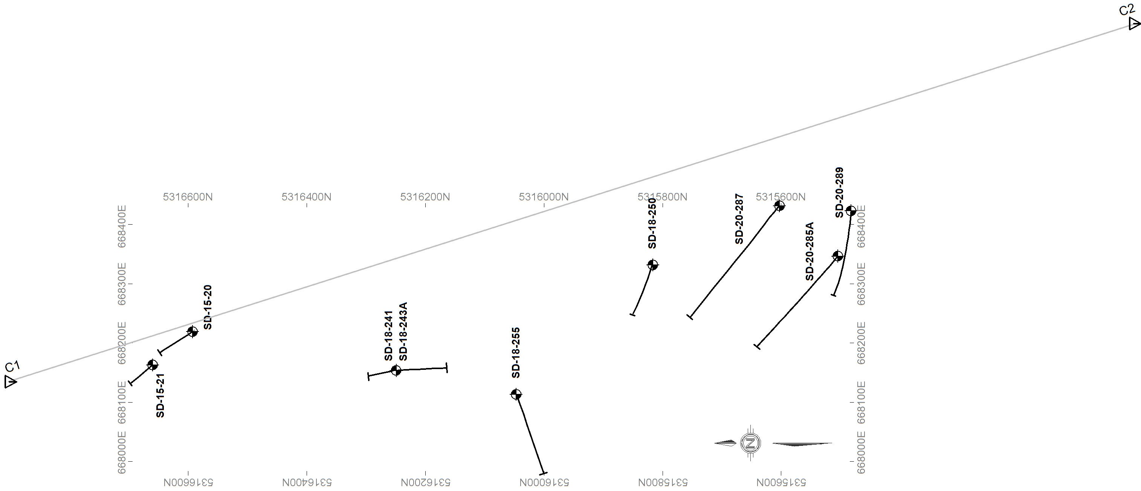
The purpose of the work was to map trends and zones in 3D at a NW Ontario gold exploration project
  Anchor-hole at 50m or 100m intervals, Paired-hole at 5m, 10m, 20m and 30m intervals,
  Transmitter at just over 2 Amps,
  C1-C2 = 2 km apart.
9 BH Pairs:
SD-18-241 and SD-18-243A
SD-18-241 and SD-15-20
SD-18-241 and SD-15-21
SD-18-243A and SD-18-255
SD-18-250 and SD-20-289
SD-18-255 and SD-20-285A
SD-18-255 and SD-20-287
SD-20-287 and SD-20-289
SD-20-289 and SD-20-285A

Slide 14
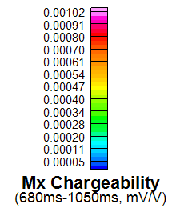
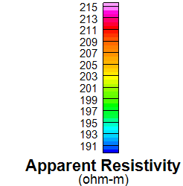
‘Minto B Shear Zone’ corresponds with a resistivity low (left image) and chargeability high trend (right image).

Slide 15
‘Minto Mine South Shear Zone’; resistivity voxel sliced further north on the left; indicates a potential fold structure with limbs sandwiched around the shear zone.

Slide 16
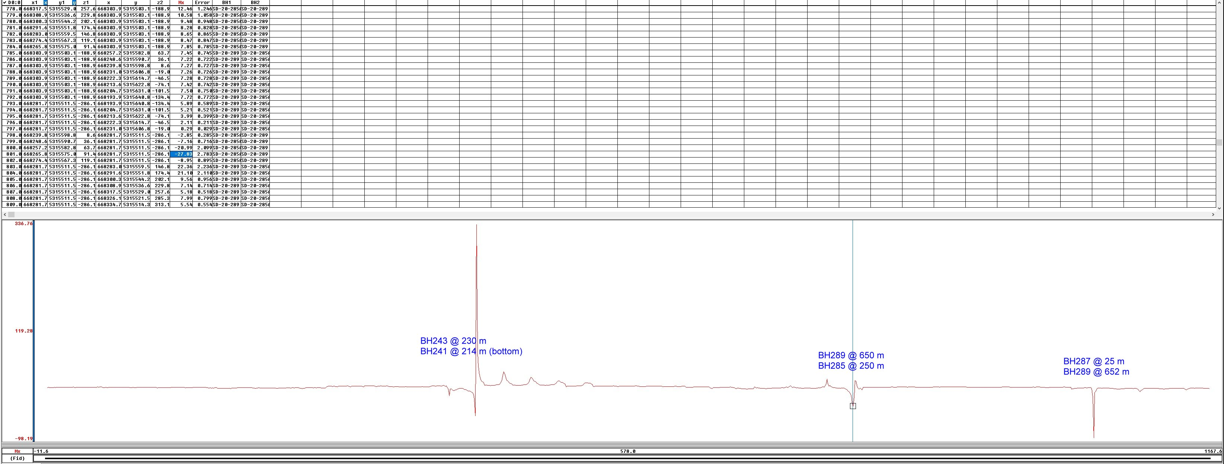
Three significant near-hole chargeability peaks were noted in the chargeability profile referenced to their borehole pairs displayed below (source: Mx_obs.gdb).

Slide 17
The Future
Multiple receiver dipoles for multiple borehole pairs read at the same time.
Automated ‘robots’ to operate the winch of each reading.
Customized software to receive these data and convert to preferred 3D Inversion modelling routines.
Quantitative Interpretation of near-borehole anomalies and effects.
Modeling various target scenarios: gold, base metals, etc.

Slide 18
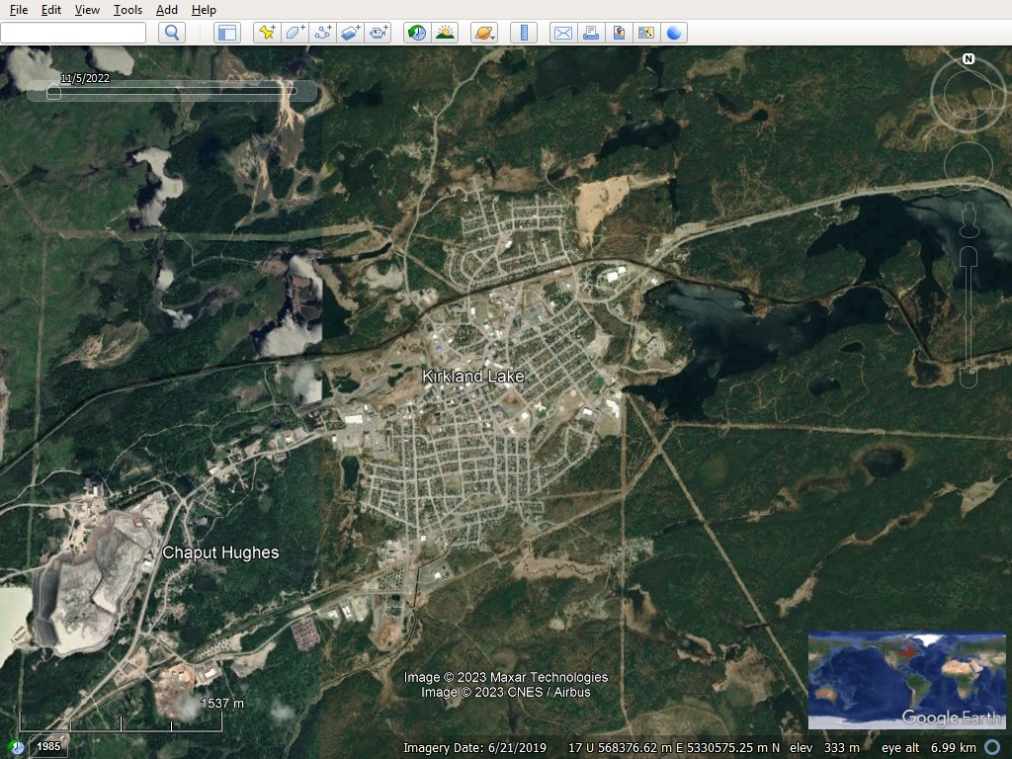
The Future

Slide 19
The Future
The Macassa mine, located in the Town of Kirkland Lake, Ontario, remains one of the highest gold grade mines in the world. Since its initial discovery in the area in 1911, gold has been a staple in the town’s history. Between 1905 and 1935, a multitude of mines opened in the area that produced collectively more than 23 million ounces of gold in the 20th century.

Slide 20
The Future
Macassa was in continuous production from 1933 until 1999, when operations were suspended and placed into care and maintenance due to the declining gold price.
Macassa resumed operations in 2002, and with the discovery of the high-grade South Mine Complex (SMC), was able to increase production levels significantly above historic levels and make Macassa one of the highest grade gold mines in the world.
Successful ongoing exploration drilling continues to extend the SMC mineralization and add to the mine’s mineral reserves and mineral resources in support of extending mine life.
The commissioning of the Shaft #4 production hoist in the first quarter of 2023 has started a new chapter in the life of the Macassa mine, with the new shaft expected to increase production, lower unit costs, improve working conditions, and increase exploration capacity. The SMC was a significant discovery, with the zone having a different character than the zones mined historically at Macassa.
The SMC is associated with a cross-over structure that links the ’04 / Main Break with the Amalgamated Break. The mineralization trends parallel to the main structures but has a much flatter dip ranging from 20 to 50 degrees south. SMC mineralization has been found to have greater widths and contain higher grades than the main zones. Considerable potential exists for future exploration drilling to identify additional parallel and stacked zones located above, below and along strike of the known SMC Zone.
Source: https://www.agnicoeagle.com/English/operations/operations/Macassa-Mine/default.aspx

Slide 21



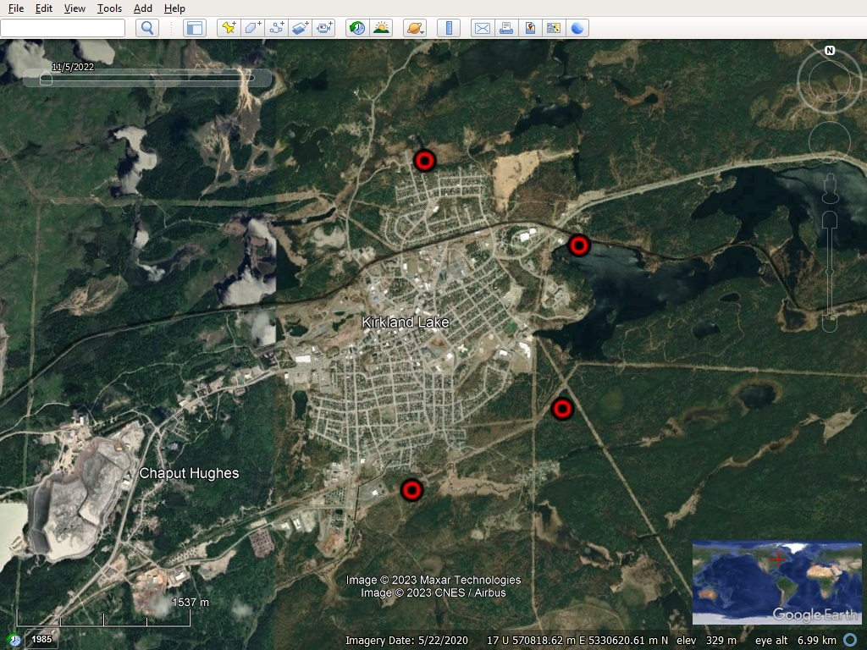
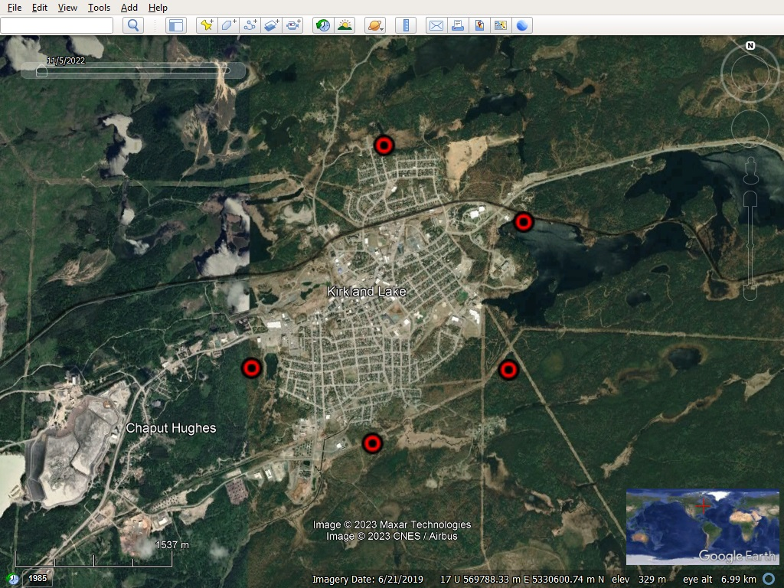


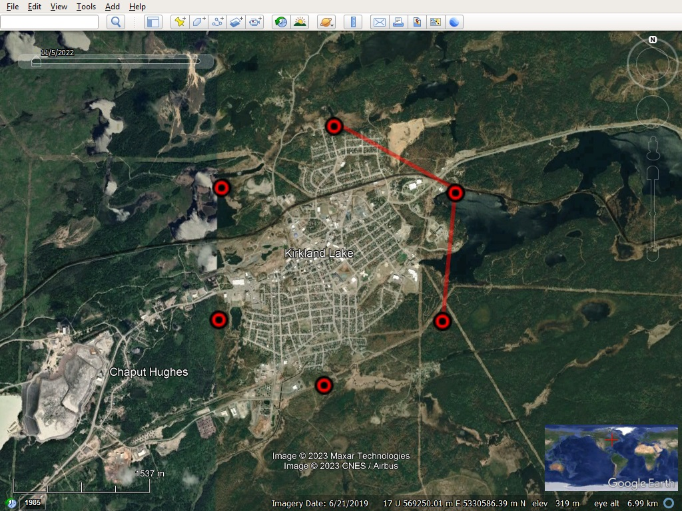
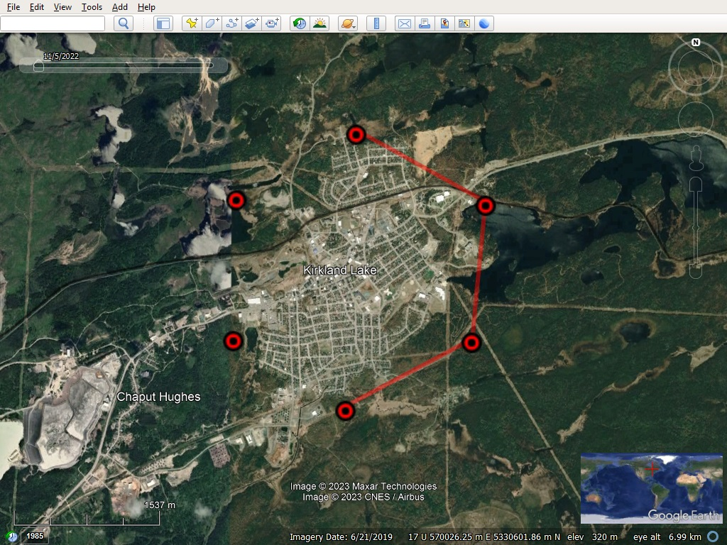
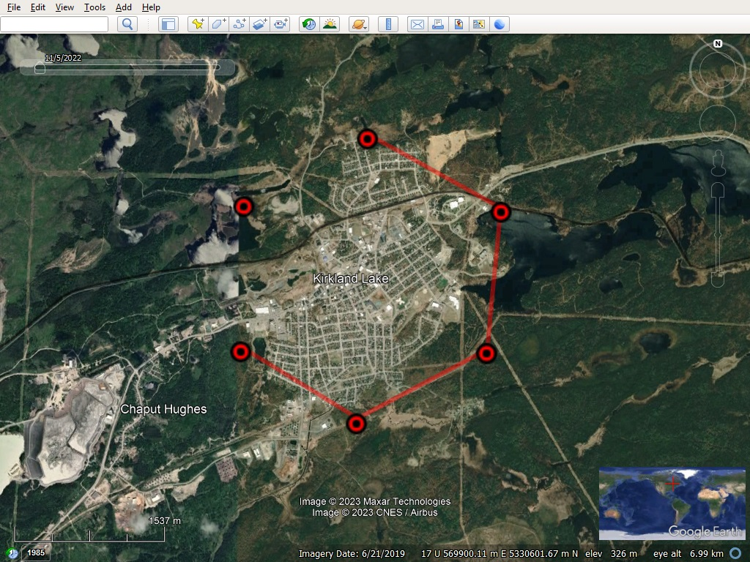





The Future

Slide 22
Thank-you:
Mauro Cortes at wsp.
Ron Howieson at Stantec.
Quentin Yarie at Red Pine Exploration.

